Slide 1
LONG TERM CAPACITY PLANNING
Team- LCP 04
Predicting water demand for Mumbai in the next 10-15 years
Mentor :- Sayali Vaidya
Team Members
Samyukta Nair
Shivam Panchal

Slide 2
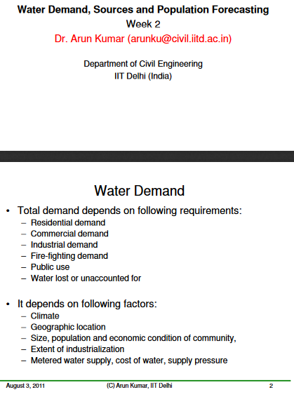
INITIAL RESEARCH

Slide 3
INITIAL RESEARCH
Factors from publication paper:
Residential - urban and slum
Commercial
Industrial
Public use
Leakages and losses
Climate

Slide 4
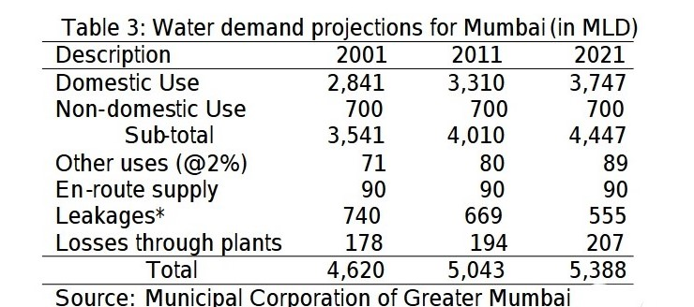
DATA COLLECTION AND CALCULATION
Domestic | Commercial | Industrial | Public use | Enroute | Leakages | Losses
150 lpcd-urban 40 lpcd-slum | 20lpcd | 400MLD | 2% of total of domestic and non domestic | Pegged at 90MLD | Targetedly reduced by 4% every 10 years | Around 200 MLD

Slide 5
DATA COLLECTION AND CALCULATION
Climate data- weatherunderground, worldweatheronline
Yearly population- macrotrends-2001-2019
Census – urban vs slum population
BMC calculations: deputy hydraulic engineer(planning)
Constant annual growth rate formula=
(end value/start value)^((1/periods-1)-1)

Slide 6
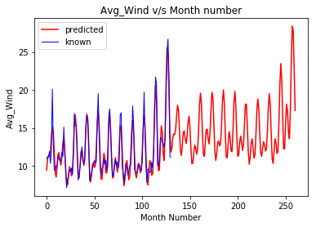
APPROACH
Top Features
Population
Domestic Usage
Non domestic Usage
Leakages
Losses
Other uses
Random Forest Algorithm.
Feature importance: More than 0.01%.
Retrained the model on these top features.
Fast fouriers transform for time series prediction.

Slide 7
FACTORS IN LONG TERM
Climatic factors - Insignificant
Domestic - Slum down from 54% to 42% from 2001 to 2011

Slide 8
THANK YOU

